Slide 1


The modern solution TO one of music’s oldest problems.
Developed by Evan Reca

Slide 2
Project Summary
The Problem
Consumers searching for specific pieces of classical music lack a streamlined method for finding and listening to the classical arts without having to source a multitude of collections from differing providers (e.g., Youtube, Spotify, etc.)
The Solution
Klasyx aims to aggregate the entirety of the accessible classical music genre throughout recorded history to provide a simple way for consumers to find any piece of classical music with zero hassle — allowing them to easily search for and save what they want to listen to on their Klasyx account
Phased Development Approach
The Klasyx Project will be divvied up into a series of design and implementation phases to facilitate the development process

Slide 3
What makes Klasyx stand out?
Zero Advertisements
Popular music platforms are private businesses. As such, they run ads to generate revenue. Klasyx is not only free to the public, but it’s also completely ad free.
Genre Specificity
Allowing music of any genre onto your platform inevitably bloats it with options that your consumers aren’t looking for. By honing-in on the niche of classical music, it becomes easier than ever to find the songs you want every time. No covers, no remixes, no clutter.
What about copyright issues?
Because the music provided is to be entirely comprised of centuries-old classical pieces, the eventual complete Klasyx library will feature songs that are 100+ years old and thus they are considered royalty-free under U.S. law.

Slide 4
System Requirements
Once Klasyx fully launches users should be able to:
Create accounts and log in to them
Search through the Klasyx library for their songs of choice
Filter and sort searches by various criteria (composer, title, release date, etc.)
Play/Pause/Restart/Repeat their selected songs
View info about each composer registered in the Klasyx library
Create Playlists of their favorite songs
View and access the songs they’ve listened to via their user history tab
Update their account’s settings (profile picture, user info, etc.)

Slide 5
Development Tools
The software used to create the Klasyx desktop application:
Java
Java version 8 written using the IntelliJ Idea Community Edition (new to IntelliJ)
Using JavaFX to implement the client-side GUIs of the application
Microsoft Visio/Word
Using to design documentation (UML Use Cases, High Level Data Flow Diagrams, etc.)
MySQL
MySQL Workbench 8.0 Community Edition
Using to model/design the database schema
To store persisting data regarding basic user info, paths to each song file, playlist info, user history, etc.

Slide 6
Phases of Implementation
Phase One — Design and Early Implementation
Mock-up all application GUIs in Visio
Design database schema in Workbench
Begin implementing client-side GUIs
Estimated Development Time — 4 Weeks
Any additional time to be dedicated towards Phase Two
Phase Two — Client-Side Implementation + Initial Database Implementation
Begin/Continue work on client-side GUIs
Begin implementing database (creating it, populating it, and connecting it to the application)
Estimated Development Time — 4 Weeks
Phase Three (2.5) — Finalization
Work on client-side to be near completion
Continue and complete database implementation
Estimated Development Time — 4 Weeks

Slide 7
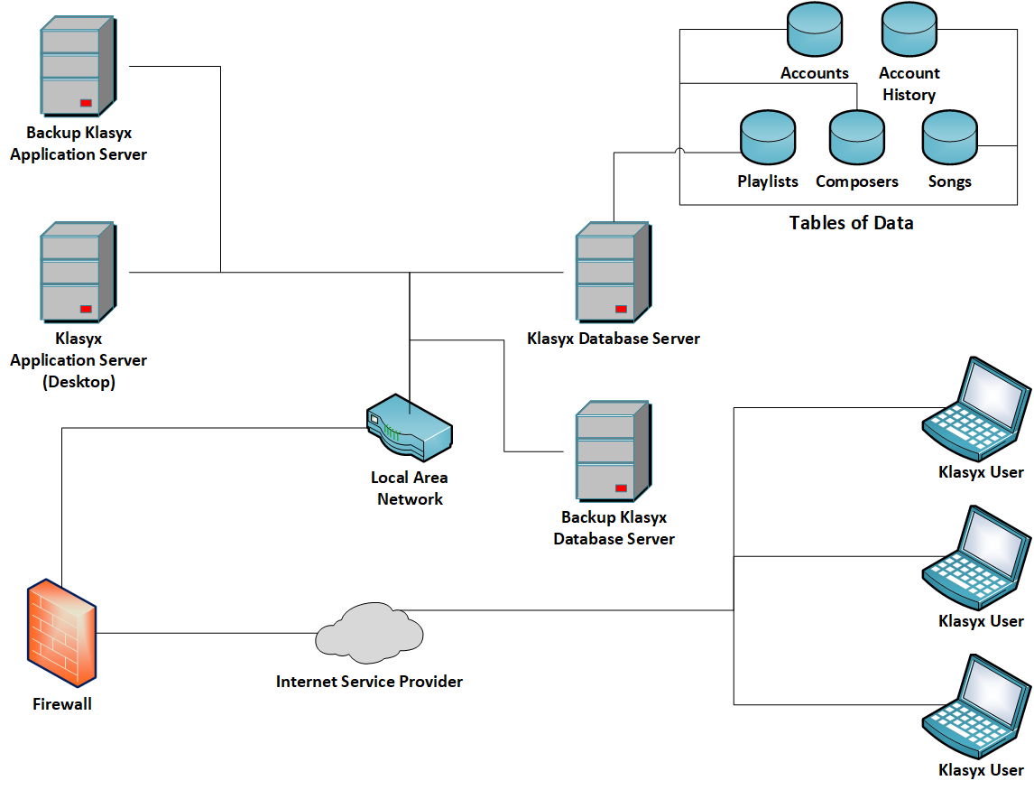
Klasyx
Music Player
System
Architecture
Diagram

Slide 8
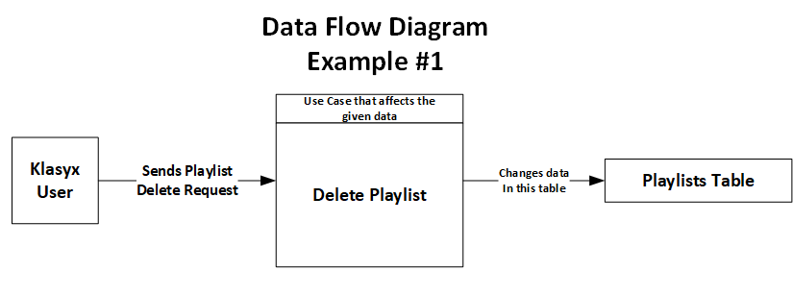
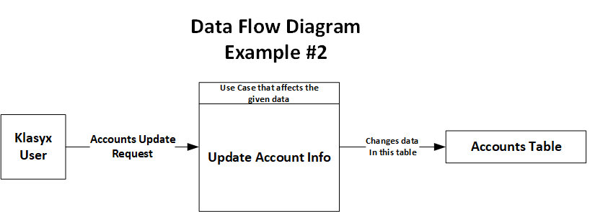
Klasyx
Music Player
High Level
Data Flow
Diagrams

Slide 9
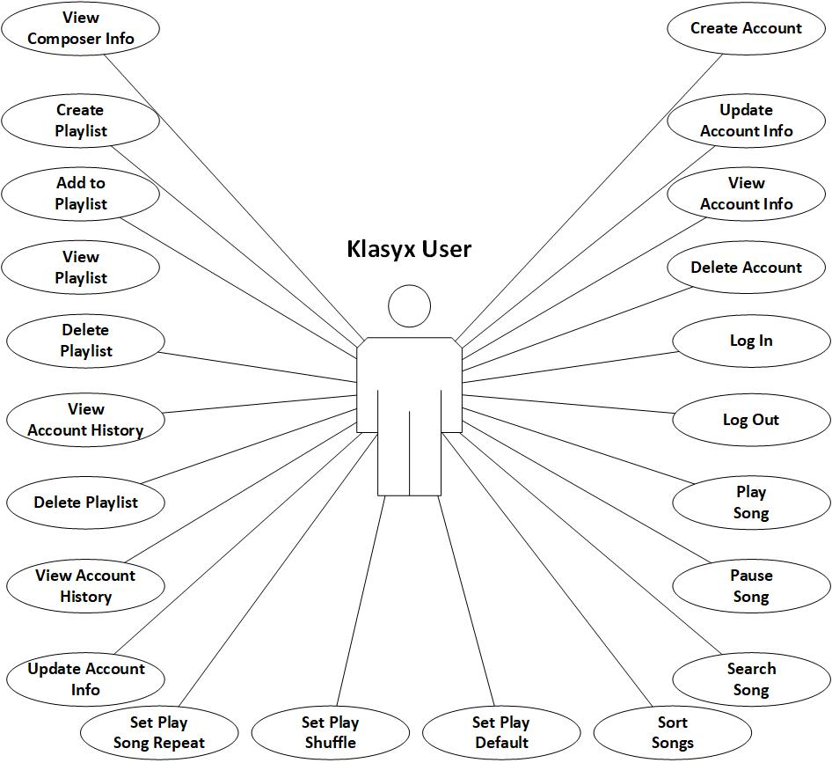
Klasyx
Music Player
Use Case Diagram
(only one type of user exists)

Slide 10
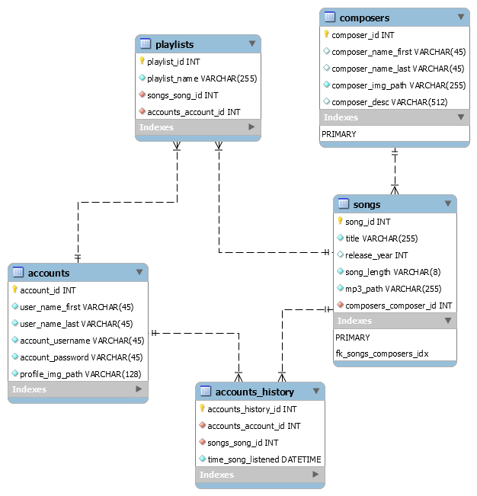
Klasyx
Music Player
Database
Schema

Slide 11
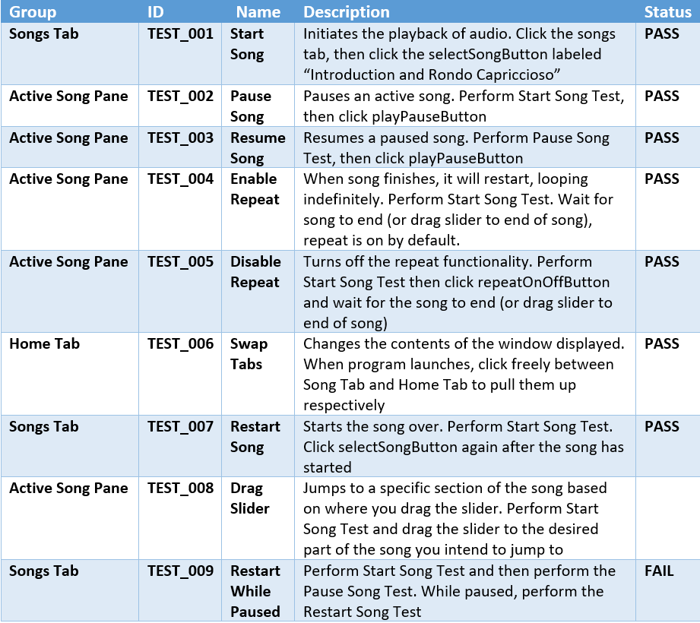
Klasyx
Music Player
High Level
Test Cases

Slide 12
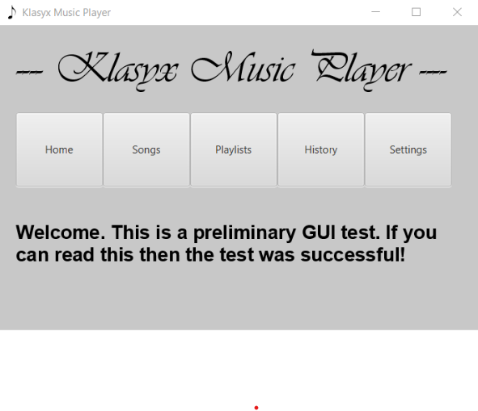
Klasyx
Music Player
Sample Image
Pre-Alpha
Home Screen

Slide 13
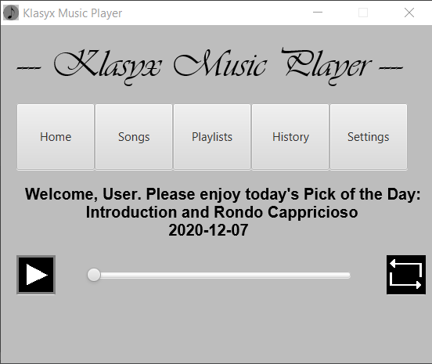
Klasyx
Music Player
Sample Image
Alpha (Current)
Home Screen

Slide 14
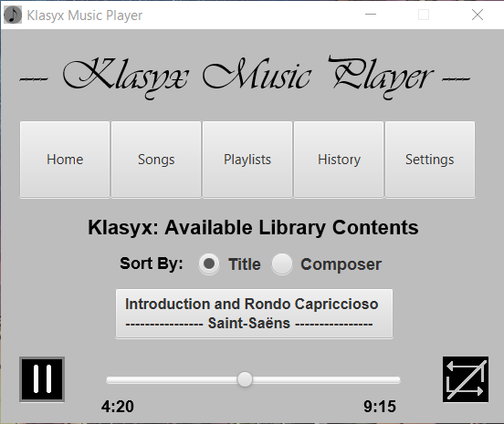
Klasyx
Music Player
Sample Image
Alpha (Current)
Songs Tab

Slide 15
Let’s launch the program!

Slide 16
Bugs and Challenges
Known Bug — Restarting While Paused
Attempting to restart the song when it’s paused causes an IllegalArgumentException at line 415 likely because the selectSongButton event handler is attempting to insert the timestampPane into the activeSongPane a second time (using the add method at line 415) after it’s already done that once before when the selectSongButton is clicked the first time
Doesn’t crash the program. Attempting to restart the song again after it fails triggers a proper restart.
Challenges
Connecting the Slider Control to the Audio Player Object – after researching the different methods built into Java’s Slider control more thoroughly, it became clearer how to properly increment it in time with the song.
The IDE (IntelliJ) also facilitated the correction of the syntax errors I was getting trying to handle the Mouse Event of dragging the Slider

Slide 17
Klasyx – Moving Forward
Post Semester Updates
Alpha → Beta
Implementation of the User Accounts System as well as the inclusion of multiple songs to bring Klasyx beyond its initial proof of concept
Multi-Platform Distribution
Klasyx is currently a desktop-exclusive platform. Klasyx Mobile for android and iOS as well as klasyx.com are the next natural steps to take
Offline Mode
You need to connect to the Klasyx server to listen to the Klasyx library, but access to direct downloads for offline play is planned for a future update.
Licensing
To create a more complete platform, 100% of funds donated to Klasyx after launch will be used to acquire the rights to distribute classical pieces from 1920’s – Present

Slide 18

Thank You!
—

